Slide 1


Agenda:
Background and Introduction
Procurement Guidance
Requisitioning, Purchase Orders and Miscellaneous Instructions
Accounts Payable and Pcard
Rev: 04/05/18

Slide 2
Agenda:
Letter of Understanding (LOU) as of February 19, 2018
Scope of services - BU:
  Purchase of goods and services
  Acquisition of construction design services and construction services
  Management of purchasing card program
  Responsibilities – MU:
  Enforcing compliance with procurement processes, policies, and procedures; and
  Meeting all contractual obligations, including payment for goods and services received
  Adopting Bloomsburg University’s procurement, construction and p-card processes and procedures
  Note – Both universities share the same legal counsel

Slide 3
Bloomsburg Team
Name | Title | Phone | email | Primary Duties | P Group
Jeff Mandel | Director of Procurement | (570) 389-4045 | jmandel@mansfield.edu | Program support | 554
Jeff Ulanoski | Assist. Director of Procurement | (570) 389-4313 | julanoski@mansfield.edu | Pcard administration | 556
Brandi Yagle | Contract Specialist | (570) 389-4314 | byagle@mansfield.edu | Services/Contracts | 558
Jamie Cotner | Purchasing Agent | (570) 389-4311 | jcotner@mansfield.edu | General purchases | 557
Carrie Adams | Purchasing Agent | (570) 389-4314 | cadams@mansfield.edu | General purchases | 553
Chris Rovito | Clerk 3 | (570) 389-4311 | crovito@Mansfield.edu | General purchases | 551

Slide 4
Workflow and Procedures
  Purchasing requisition workflow at Mansfield will remain in place with individual line items in excess of $200 requiring a fiscal review and approval prior to release to Purchasing.
  Delegation of Authority from MU to BU staff is complete.
  BU will send PO’s and service purchase contracts (SPC) directly to the vendor.
  Copies of SPC’s will be sent to requestors.
  Requests for services for MU should be initiated via a purchase requisition.
  Request for Pcard additions, changes, deletions will be managed via a new form (Purchasing Card Change Request) maintained by MU’s Controller’s Office.
  Bloomsburg University will add new vendors for Mansfield University (both Purchasing and Accounts Payable).The vendor name, address, phone & fax numbers, e-mail address, and point of contact needs to be provided by the end user so that Purchasing can contact the vendor for appropriate paperwork.

Slide 5
Miscellaneous
  Telephone system – MU staff will call the 4148 extension to reach the call tree.
  User should enter full requestor name vs. only initials
  If the vendor has an email address, include in the header note.
  Payment terms will be net 30 days unless requested or noted otherwise on the invoice.

Slide 6
Presidential Delegation of Authority Purchasing and Contracting
Peter Fakler Interim President
Kathryn Crossin Interim VP for Finance and Administration Unlimited
Jeff Mandel Director of Purchasing $100,000
S. Renee Potter Controller Unlimited (in absence of the VP A&F)
Brandi Yagle Contract Specialist $10,000
These are the only individuals authorized to sign any contracts, leases, license agreements, etc. on behalf of Mansfield University
The University President and his/her designees are the only individuals authorized to enter into contracts on behalf of MU.
No other person or department head has authority to sign or obligate the university by entering into any contractual agreement on behalf of the university or any subdivision thereof

Slide 7
Procurement Guidelines

Slide 8
Key Points for Purchasing
Purchasing Limits
Purchases less than $10,000 do not require advertising or competitive bidding. While bidding is not required the University encourages departments to solicit quotes, take advantage of volume discounts, and use any other techniques to obtain the lowest possible prices.
Purchases from $10,001 - $20,600 may require 3 formal quotations. This process may include telephone, fax, internet, or other electronic price quotes. Price quotes must be electronically attached to the requisition.
$20,600 and Higher - Requires Competitive Bidding
Bidding Requirements
As a public university and a member of the Pennsylvania State System of Higher Education (PASSHE) certain bidding requirements are either mandated or have been adopted as good business practice. Under ACT 57, Pennsylvania law dictates that bids will be solicited for all purchases exceeding Twenty Thousand Six Hundred Dollars ($20,600).

Slide 9
Exception to Competitive Bidding Process
Exceptions to competitive bidding may apply under the following circumstances:
  When the goods and services can only be procured from one source (Sole Source) and a Sole Source Certification has been completed with justification; must be approved by the University Legal Counsel. When we have an existing system in need of maintenance, repair or upgrade and only a single contractor is capable of providing the good and/or service;
  When the needed goods and services are on a “STATE CONTRACT, SYSTEM CONTRACT or COSTARS”;
  When purchasing from the Commonwealth Warehouse;
  When purchases are required with Unique Source (formerly known as Pennsylvania Industries for the Blind and Handicapped (PIBH));
  When goods or services must be obtained on an emergency basis, an Emergency Contract Certification form is completed with justifications and approved by the University Legal Counsel. ‘AFTER THE FACT PURCHASES’ doesn’t make it an emergency.

Slide 10







Contracting Mechanisms
Other specific/limited mechanisms:
TCPN – Lowes
National IPA – Grainger & CDW-G
US Communities – Graybar, Trane, Cintas

Slide 11
Other
Emergency Contract: permissible in circumstances that are a threat to public health, safety, and welfare.
  Where possible, discuss with University Legal Counsel.
  Two bids are required.
  Work can begin before the legal process is completed; however, the legal approval process is still required.
Sole Source: Implies there is only one person or company that can provide the contractual services needed.
Prohibited Contracts
  Employee/Employer Relationships;
  Contracts for the purchase of insurance. An exception to the rule is collision insurance for rental vehicles;
  Attorney Services.
Memorandum of Understanding (MOU): Agreement between MU and other state agencies and university affiliates (CCSI/Foundation). Must be reviewed by University Legal Counsel.
Letter of Agreement (LOA) or Letter of Understanding (LOU):
  An agreement/understanding between PASSHE schools
  LOA or LOU is not a contract and cannot take the appearance of a contract
  Must be approved by University Legal Counsel

Slide 12
Types of Contracts and PO’s
Type | Description/Use | Encumbers Funds
Purchase Order (PO) | Purchase of goods (i.e. office supplies, computers, furniture, books). The PO is signed by the Contracting Officer. All PO’s reference 45# | Y
Service Purchase Contract (SPC) | Purchases of services (i.e. consultants, performers, piano tuners). SPC’s are signed by the vendor, and Univ. and legal counsel (OAG/OGC) as needed based on $ value of contract. All SPC’s reference 40# | Y
Outline Agreements (OA) | Facilitate repetitive orders to single vendor (Bottled H20, hearing aids, bulk commodities) Allows single contract to capture all associated PO spend. Issue separate PO’s that reference 46# Can be configured for multiple years with PO’s issued on annual year basis Can be configured for multi-using depts. (separate line for each) | N
Service Purchase Outline Agreement (SPOA) | Repetitive service requirements (i.e. Maintenance repair contracts) Limit to $20.1K/yr Require new PO for each FY Reference 47# | N

Slide 13
Types of Contracts and PO’s
Type | Description/Use | Encumbers Funds
Blue Back Contract | More complicated procurements and associated transaction (ex. student loan mgt). Signed by the vendor, Univ., legal counsel, AG and OGC based on $ amount of the contract. | N
Construction Contract | New construction, renovations and improvements to buildings. Construction contract signed by the contractor, Univ., legal counsel, AG and OGC based on $ value of the contract. (PO signed by Contracting Officer) Reference 39# | Y
Pcard | Typically assigned a single transaction $ limit and a monthly $ limit determined in cooperation by the University Controller & Purchasing. Certain university operations may be assigned a higher per transaction or monthly dollar limit where appropriate and approved by the University Controller and Purchasing. Current level approved by Executive Mgmt is $500 per single transaction with various monthly limits depending on the area of university operations. | N (batch monthly to expense)

Slide 14
Prohibited Contract Clauses
  Assignment: No assignment without the prior written consent of the university.
  Legal Jurisdiction: The laws of the Commonwealth of Pennsylvania must govern.
  Attorney Fees, Court Costs, Entry of Judgment: The university may not voluntarily pay the contractor’s court costs or legal fees nor may it allow a contractor to confess judgment on its behalf.
  Indemnity and Hold Harmless: Removed from every Commonwealth contract because it compromises the greatest protection afforded the Commonwealth entities: sovereign immunity.
  Arbitration: Resolution of disputes by binding arbitration in contracts for goods and services is prohibited. The Board of Claims has exclusive jurisdiction.
  Payment in Advance: Prohibited except as justified in writing.
  Purchase of Insurance: State System of Higher Education universities may not purchase insurance. Vehicle rentals are an exception.
  Labor and Industry approval must be obtained for the addition or movement of utilities. Permits take an average of eight weeks to obtain. When purchasing new equipment, Physical Plant should be notified.

Slide 15
Conflict of Interest
“No University employee may use his or her University position to obtain financial gain or anything of substantial value for the private benefit of himself or herself or his or her immediate family. Rebates, free merchandise or future benefits based on purchases made with University funds (including Purchasing Card purchases) must be signed over to the University.”

Slide 16
What is a Requisition (PR)?
A Requisition is the recognition of a need for a good within a department.
A Requisition is not a legally binding document.
Approval of a Requisition by a budget holder is the agreement that the need should be satisfied and the budgeted funds are available.
The Requisition is an authorization for the Purchasing Department to purchase the specified materials.

Slide 17
Required Information for a PR
Check the Public Funds Policy to ensure the purchase is allowable.
Ensure funds are available in your dept. budget
  MU Logos must be approved by the Marketing/PR office.
Obtain vendor information
The PR must provide detailed information about the commodity so the approving authorities can accurately understand the request: # of items, size, color, model#, etc. PR’s submitted without necessary detail will be returned to creator so details can be provided.
Any supporting documentation must be attached to the PR: quotes, correspondence, Food/Beverage & Gift/Award approved justification forms, etc.
PR must be coded correctly; reference MU’s Commitment Item/GL List for descriptions of commitment item #’s and related material group. Requisitions with inaccurate commitment item or material group codes will be returned to creator to be corrected.
Ensuring all of these steps are taken will greatly reduce the turn around time for a Purchase Order.

Slide 18
What is a Purchase Order (PO)?
A Purchase Order is used to purchase commodities.
Commodity: Something that is bought and sold; an economic good; a useful or valuable thing.
The Purchase Order is the document that legally binds the University (contract).
A Purchase Order is the purchaser’s offer to purchase and authorization to formalize a purchase transaction with a supplier.

Slide 19
What is a Service Purchase Contract (SPC)?
If a vendor will be providing a service to the University, a Purchase Requisition must be processed and a Service Purchase Contract (SPC) signed prior to the service being provided.
Examples of Service Purchases: consultants, external reviewers, equipment maintenance/repairs, rentals of tents and other equipment, speakers or entertainers, print screening, embroidery, annual inspections & preventive maintenance, photographers, outside coaches, scorekeepers, & officials for athletic camps, food vendors, conferences at hotels, bus trip arrangements, interpreters, models, workshops or training to be held on campus, etc.
Why is this important? PASSHE has a set of standard terms and conditions attached to the SPC that the vendor agrees to by signing the document. These T&C’s protect the interest of the University, PASSHE and the Commonwealth. Additionally, payments for services must be reported to the IRS by Accounts Payable as applicable.
All contracts need to go through Purchasing Department to have the terms and conditions reviewed. Once the T&C’s have been vetted the contract will be signed and a SPC or PO created.

Slide 20
Service Purchase Contract
The Purchase Requisition must contain detailed information and any supporting documents related to the service attached. The following are some of the required information: department name, fund center, vendor name, address, phone number, social security number/federal ID, contact person, cost of the service, a detailed description about the service to be provided. For detailed requirements see the Purchasing Department User’s Guide on the Purchasing home page.
The Purchasing Department will process the request per the timelines set forth in the Purchasing Departments Policy and Guidelines. (See Purchasing Department User’s Guide on the Purchasing home page)
No vendor/contractor should perform any service to the University without an executed Service Purchase Contract in place.

Slide 21
Contracting for Speakers
SPC must be executed between BU and speaker/speaker’s booking agent prior to engagement.
1. Initiate a Purchase Requisition (PR).
  a. Lead times below must be followed:
    i. >$5,000 – 4 weeks prior to engagement to allow Procurement time to create contract, work through contract issues with the speaker, and obtain speaker and PASSHE legal counsel signatures;
    ii. $5,000 and <– 2 weeks prior to engagement to permit time to review, edit terms and obtain all signatures.
  b. Include all pertinent information on the PR in SAP:
    i. Speaker’s quotation and/or contract (add as attachment to PR);
    ii. Name, address and phone number;
    iii. SSN of the speaker or EIN of the booking agent;
    iv. Speaker’s fee;
    v. Travel expenses (lodging, meals, mileage, etc.) – select one of the following methods:

Slide 22
Contracting for Speakers
1. All Inclusive Fee (Preferred Method)
a. Establish a set fee with the speaker, agreed upon in advance, which includes all expenses. | b. PR - Line 1 will state "Speaker's Fee-Note: Mansfield University is not responsible for any travel expenses". | c. To determine reasonableness of included expenses, please reference current per diem and lodging rates and mileage calculator found on the University's Travel Information webpage.
2. Travel Expenses Reimbursed to Speaker
a. Estimate of travel expenses must be in accordance with University travel guidelines (see 1.c. above). | b. PR - Line 1 will state "Speaker's Fee". | c. PR - Line 2 will state "Estimated reasonable travel costs (lodging, meals, mileage, etc.) - receipts required". | d. Item Text will state "Speaker will make travel arrangements, pay for travel costs, and invoice Mansfield University accordingly".
3. Travel Arrangements Made by MU
a. PR - Line 1 will state "Speaker's Fee". | b. Item Text will state “Mansfield University will arrange and pay for travel costs (lodging, meals, etc.)". | c. Note: travel arrangements must be in accordance with University travel guidelines (see 1.c. above) and can be made using the purchasing card or purchase requisition system.

Slide 23
SPC Limits & Timelines
All SPC’s over $5,000 require approval from the VP F&A. PR’s > $5,000 entered in ESS will be forwarded electronically to the VP for approval.
$5,000 and under: Complete a Purchase Requisition at least two weeks before the service is needed. SPCs $5,000 and under do NOT require approval by University legal counsel.
$5,000 to $20,600: Process a Purchase Requisition at least four weeks before the service is needed. SPCs greater than $5,000 require approval by University legal counsel. Drafting the SPC and getting legal counsel approval can add two weeks or more to the purchasing process.
>$20,600: Process a Purchase Requisition and bid specifications at least six weeks before service is needed. Sealed bids are required for purchases with a value of greater than $20,600 and require legal counsel review and approval prior to the start of the service. If the contract total is equal to or greater than $20,600, it must also go to the Office of Attorney General for approval.
No commitments of any kind must be made prior to receiving legal approval. After-the-fact requests and/or transactions will not be accepted; VP F&A, University Legal and the Attorney General will not approve after-the-fact purchases or contracts.

Slide 24
Outline Agreements
Purchasing Department can establish Service Purchase Outline Agreements for a variety of repetitive services (Quality Inn, Papa V, etc.). Purchase Requisitions are required to be processed to issue payment. The Justification & Approval Form for Food must still be completed for all food services.
If you would like a Service Purchase Outline Agreement created for a particular vendor, please contact the Purchasing Department.
MIGO is not required on an Outline Agreement

Slide 25
Creating Purchase Requisitions

Slide 26
Creating Purchase Requisitions
A Purchase Requisition must be created via the ESS Portal using the Material Management tab.
The PR is processed and approved by Purchasing and will generate a Purchase Order and Service Purchase Contract as applicable.
Once the Purchase Order/SPC has been processed a copy of the approved PO will be sent to the vendor and requesting department.

Slide 27
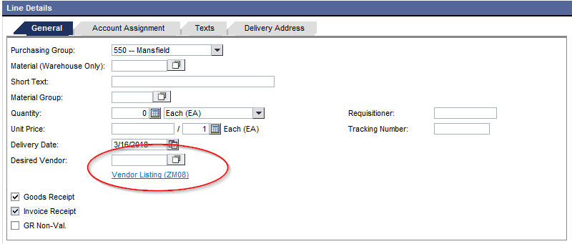
Locate Vendor Numbers in ESS
The easiest way to find a vendor number is using either the dropdown box or opening (Vendor Listing ZMO8). Both are located on the Purchase Requisition – Create screen.
In some cases there are multiple numbers for the same vendor. If in doubt, call the Purchasing Department, extension 4148 and follow call tree options.

Slide 28
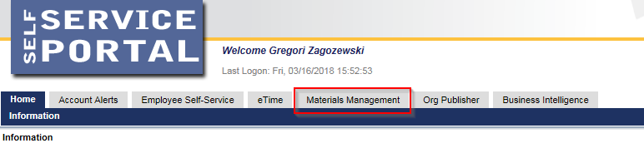
Creating a Purchase Requisition in ESS Portal
1. Logon to the Portal website: https://portal.passhe.edu
2. Click on the “Materials Management” tab as shown below:
Note: The portal screen above will vary user to user based on SAP/Portal authorizations. If you do not have the “Material’s Management” tab contact Lori Ranck @ 570-662-4174.

Slide 29
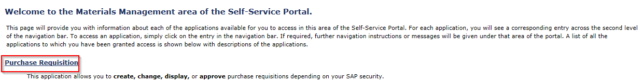
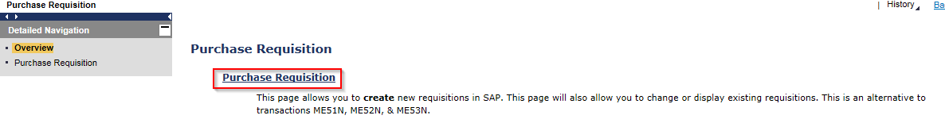
Creating a Purchase Requisition in ESS Portal
3. Click on “Purchase Requisition” links as shown below and proceed:

Slide 30
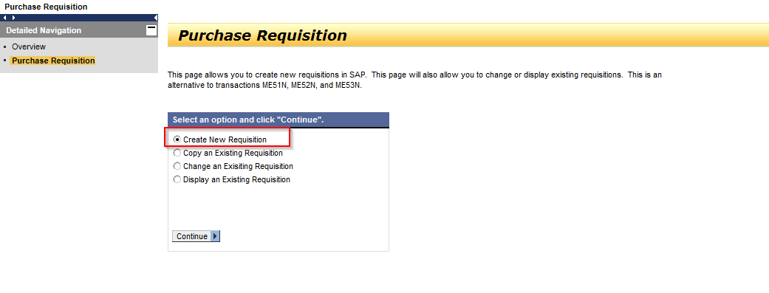
Creating a Purchase Requisition in ESS Portal
4. Click on “Create New Requisition”:

Slide 31
Creating a Purchase Requisition in ESS Portal
Notes:
Attachments can be added in create/change. If in create, you must save the requisition first and then select a line to get the attachment tab to appear.
Once saved on the portal, the requisition is immediately created in SAP.
The portal uses the same security roles assigned in SAP.
When creating a new PR, you will not see the release strategy tab (if applicable) until you save the line.
For a multiple line PR, select the appropriate line to the see the line item details.

Slide 32
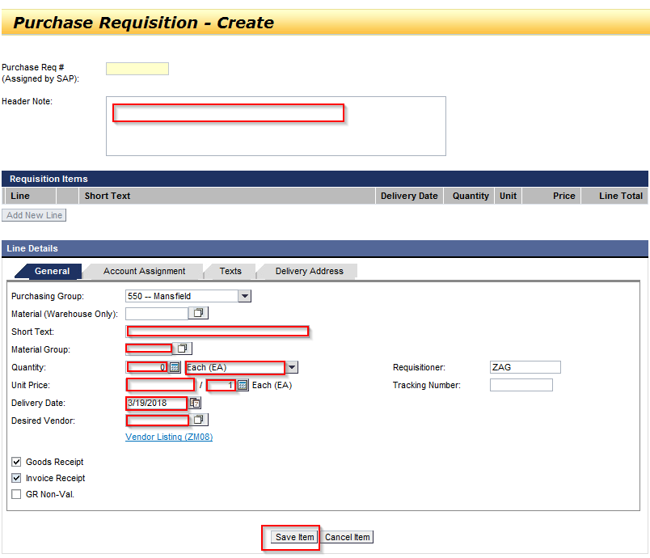
Creating a Purchase Requisition in ESS Portal
5. Click on “General” tab to enter Purchasing Group and Basic Order Info: Fill in required information. Remember to Save Item.

Slide 33
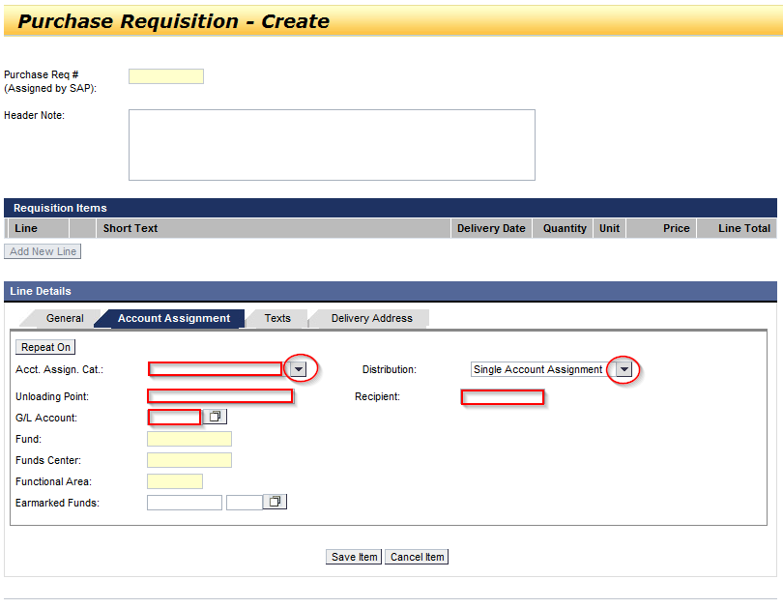
Creating a Purchase Requisition in ESS Portal
6. Click on “Account Assignment” tab to enter GL & Funds Center:

Slide 34
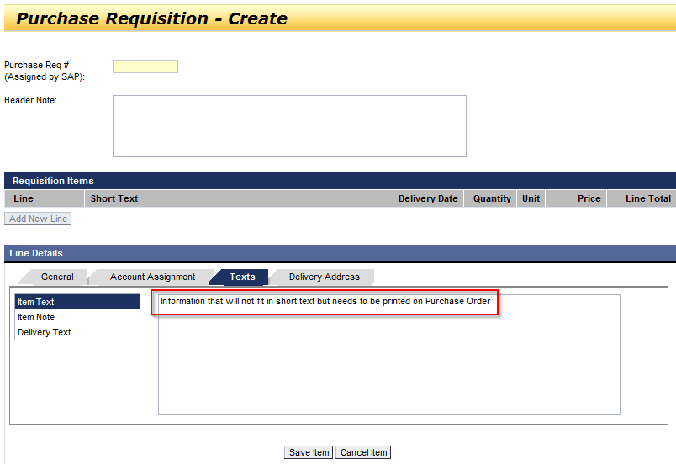

Creating a Purchase Requisition in ESS Portal
7. Click on “Text” tab to enter additional info to be printed on Purchase Order:

Slide 35
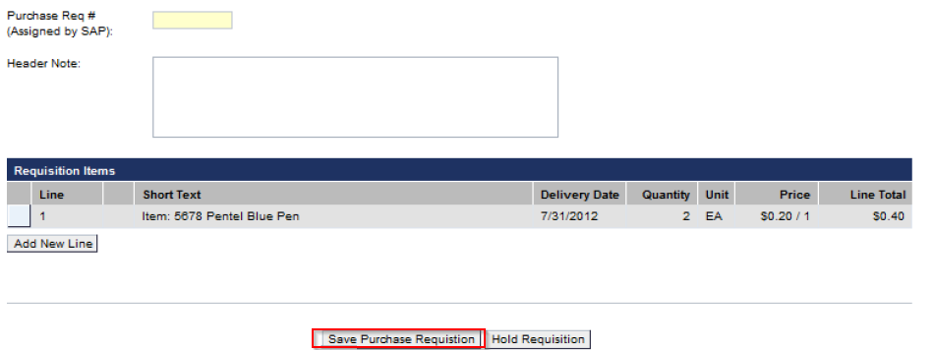
Creating a Purchase Requisition in ESS Portal
8. After the Purchase Requisition is saved, the PR # will appear at bottom of screen and in the yellow box at the top:

Slide 36
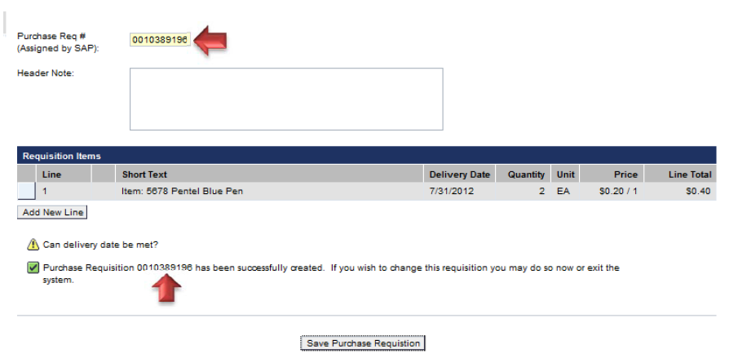
Creating a Purchase Requisition in ESS Portal

Slide 37
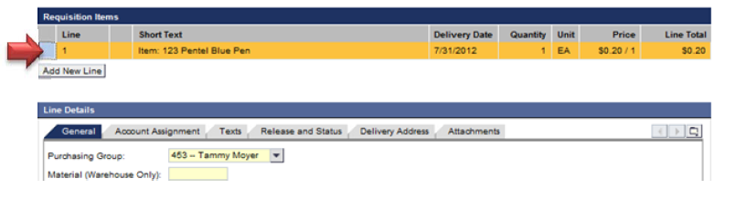
Creating a Purchase Requisition in ESS Portal
9. Adding an attachment, select line item 1….

Slide 38
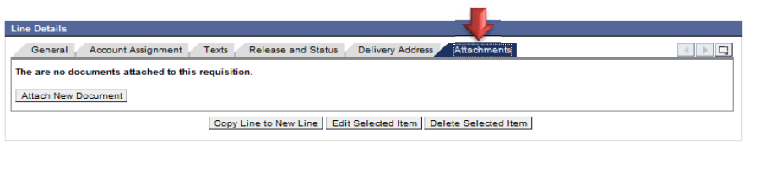
Creating a Purchase Requisition in ESS Portal
10. An “Attachment” tab will appear:

Slide 39
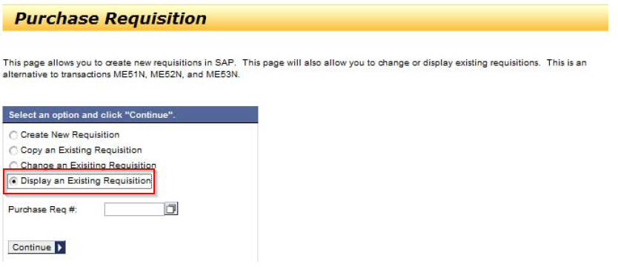
Creating a Purchase Requisition in ESS Portal
11. Display Requisition:

Slide 40
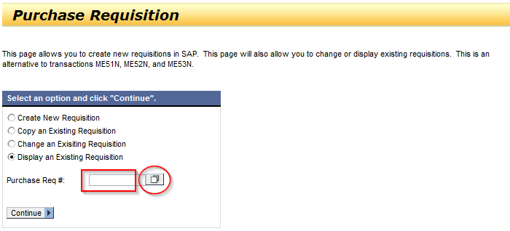
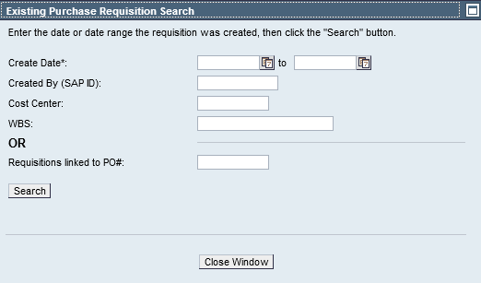
Creating a Purchase Requisition in ESS Portal
12. Searching for a Purchase Requisition you created:
Enter PR # or Search using the (Existing Purchase Requisition Search)

Slide 41
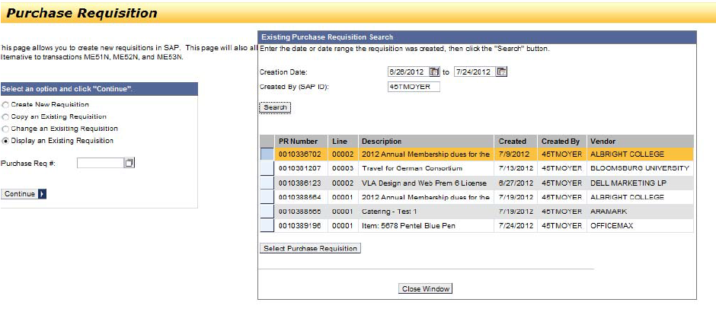
Creating a Purchase Requisition in ESS Portal
13. Click on the purchase requisition you are looking for:

Slide 42
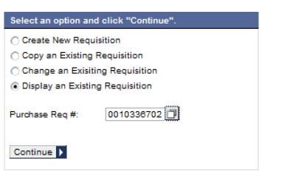
Creating a Purchase Requisition in ESS Portal
14. This will add the Purchase Requisition # to search field, click “Continue”:

Slide 43
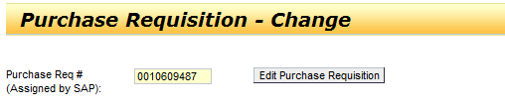

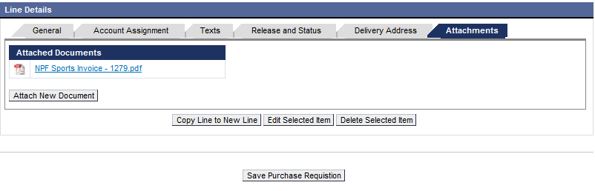
Creating a Purchase Requisition in ESS Portal
15. Attach Document: Edit PR, Attach New Document, Save Purchase Requisition

Slide 44
Purchase Requisitions – Miscellaneous
Changing initials to user name
Splitting lines
Printing

Slide 45
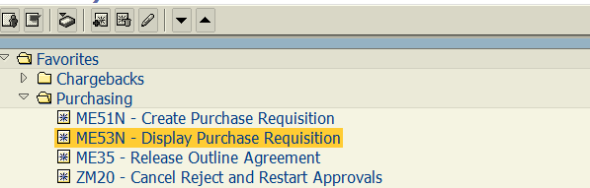
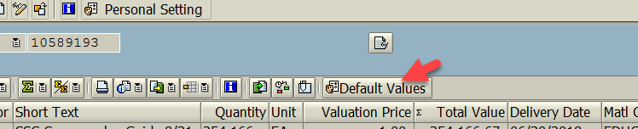
Changing initials and adding “K” to populate automatically in the ESS Portal
In the SAP Easy Access menu screen.
Click on Default Values

Slide 46
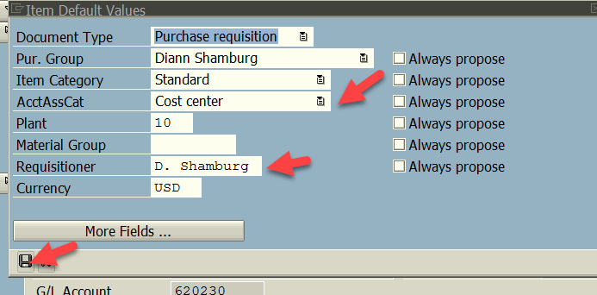
Changing initials and adding “K” to populate automatically in ESS Portal
The box below will open. The cost center (k) can be pre-set or appropriate selection as a default and change user initials to first initial and last name (as much as can be filled in if too long). Then click on the SAVE icon.

Slide 47
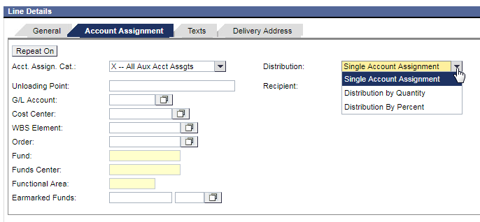
Splitting Lines on a Purchase Requisition between a cost centers and/or WBS in the ESS Portal
In General tab complete as per previous instructions.
In Account Assignment tab select Acct. Assign. Cat (X) (if both are cost center, selection would be K) and then distribute by quantity. Can use $$’s or quantity – depending on how the split will occur.

Slide 48
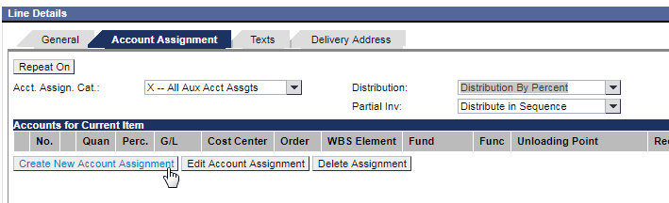
Splitting Lines on a Purchase Requisition between a cost centers and/or WBS in the ESS Portal
Next, create a new account assignment for each of the different cost centers or WBS.

Slide 49
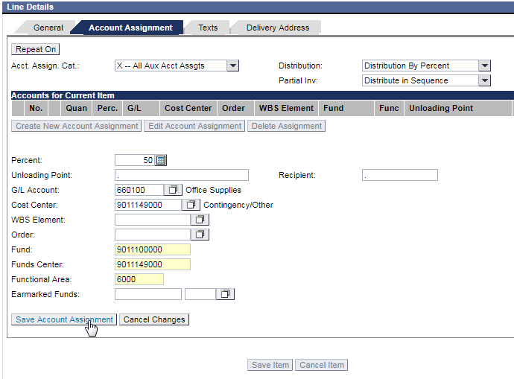
Splitting Lines on a Purchase Requisition between a cost centers and/or WBS in the ESS Portal
Assignment 1:

Slide 50
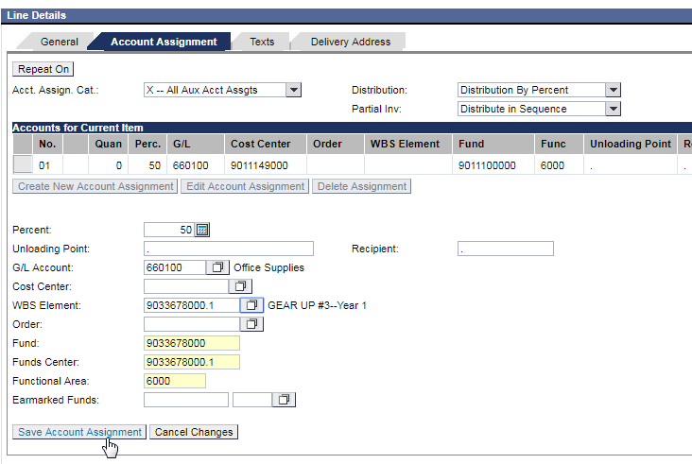
Splitting Lines on a Purchase Requisition between a cost centers and/or WBS in the ESS Portal
Assignment 2:

Slide 51
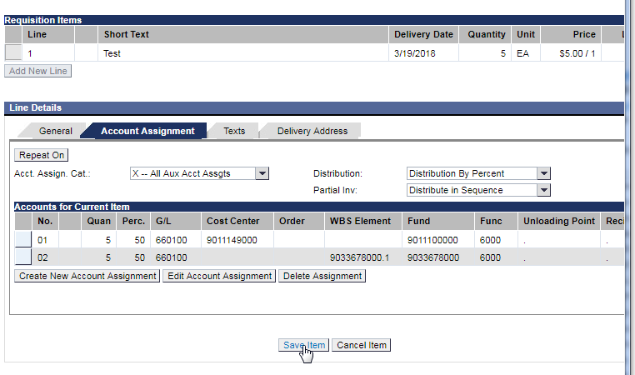
Splitting Lines on a Purchase Requisition between a cost centers and/or WBS in the ESS Portal
Next, save the item.
And then save the purchase requisition:

Slide 52
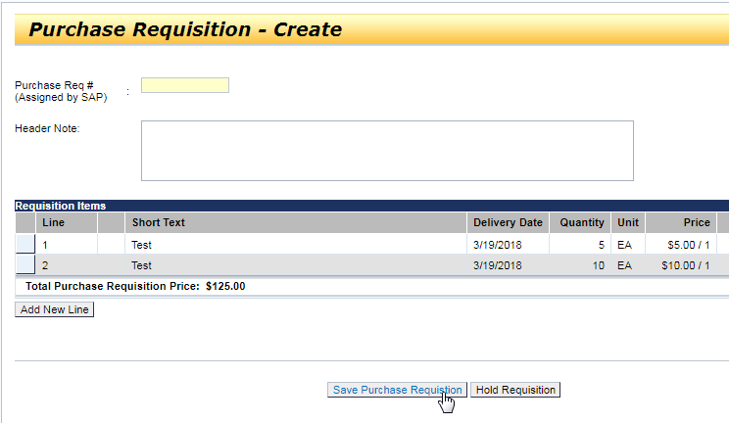
Splitting Lines on a Purchase Requisition between a cost centers and/or WBS in the ESS Portal

Slide 53
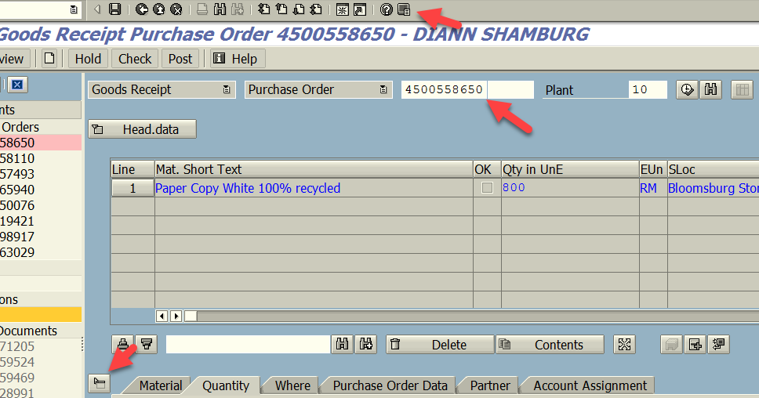
Printing a copy of lines from a PO.
From the MIGO screen used to receive items, add PO # in box with arrow. Enter.
Collapse header data and item detail (at bottom) if all lines don’t display. Since PO’s will not be sent to departments, this is a way of getting a list of items. Print a hard copy, as required.

Slide 54

Office supplies PO’s to Staples
Until expanded use of Pcard
Users shop via Staples Advantage website=> create shopping cart
Enter a PR via ESS that matches shopping cart items
PO number provided (PO not sent to vendor) to requisitioner
User process shopping cart with PO# in reference field

Slide 55
Accounts Payable and Pcard

Slide 56
Purchase Order Payment Process by Accounts Payable
AFTER items are received the requisitioner will need to release the Purchase Order for payment using MIGO in the SAP system.
Original or scanned invoices with the Purchase Order # indicated on it need to be sent to Accounts Payable.
Accounts Payable will process for payment once the MIGO is completed and the invoice is received.
Any questions please contact Accounts Payable

Slide 57
Releasing a PO (MIGO)
Check the quantity and the price against your PO before releasing. If the price is higher than the price quoted notify Accounts Payable either by email or by writing on the invoice “price difference – okay to pay,” sign and date. If quantity is different please contact Purchasing Department at extension 4148.
Only release the quantity of items received (ex: PO quantity is two but only one received).
MIGO of a PO indicates that the items were received and Accounts Payable can process payment.
Shipping/freight/handling charges not included in the initial PO will be processed manually by Accounts Payable. Do not add another line to the PO.
Memberships/subscription that cross fiscal years must be split if the amount per fiscal year exceeds $500 (ex: subscription $1,200 for Jan thru Dec; create one line for Jan-June $600 and one line for Jul-Dec $600). MIGO is not required on the line for the future fiscal year only current fiscal year.

Slide 58
Accounts Payable Payment for SPC’S
Accounts Payable can not make payment against the contract until it is approved in SAP. Once services are rendered the department will need to notify Accounts Payable to release payment. This can be done via email or writing “OK to pay” on the actual invoice.
If multiple payments are being made against the contract, please notify Accounts Payable not to finalize the contract.
If additional services are required in excess or original SPC $ value, contact Purchasing before proceeding

Slide 59
Pcard Process
Please refer to the Purchasing Card Policy and Procedures for proper use.
Each transaction has to be allocated to a cost center number and GL/Commitment Item number via a drop down menu, and a description of the purchase provided.
Each transaction has to have the corresponding receipt(s) attached.
Individuals should print a report from Bank of America (Works) for each card of responsibility.

